Slide 1
Metadata Analysis
Using R
Matt Watts
Kristal Spreadborough
Research UNE, Dixson Library

Slide 2

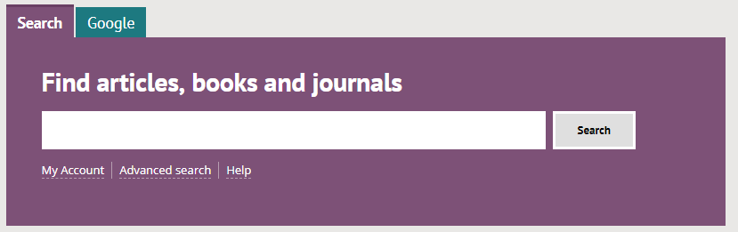
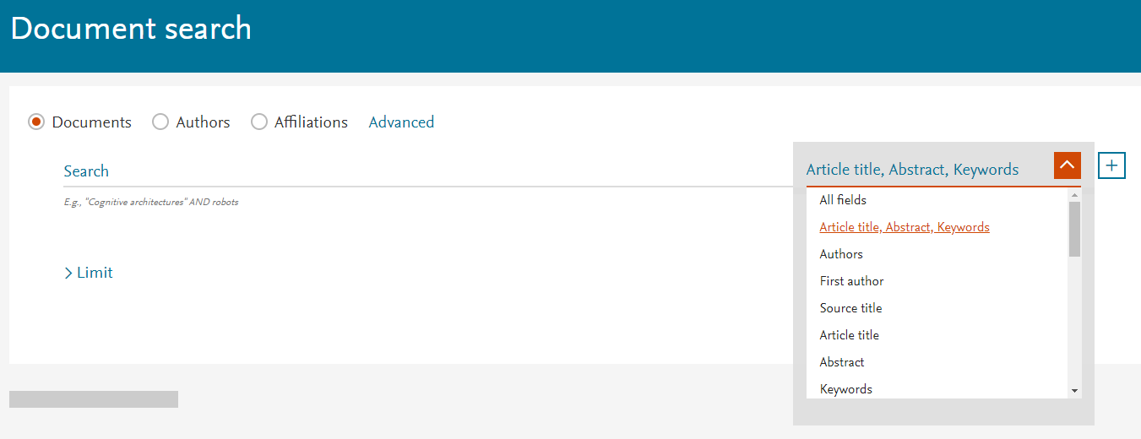
What is metadata analysis?
Metadata is the stuff that describes a thing.
For example, list of authors, title, and abstract.
Metadata is valuable.

Slide 3

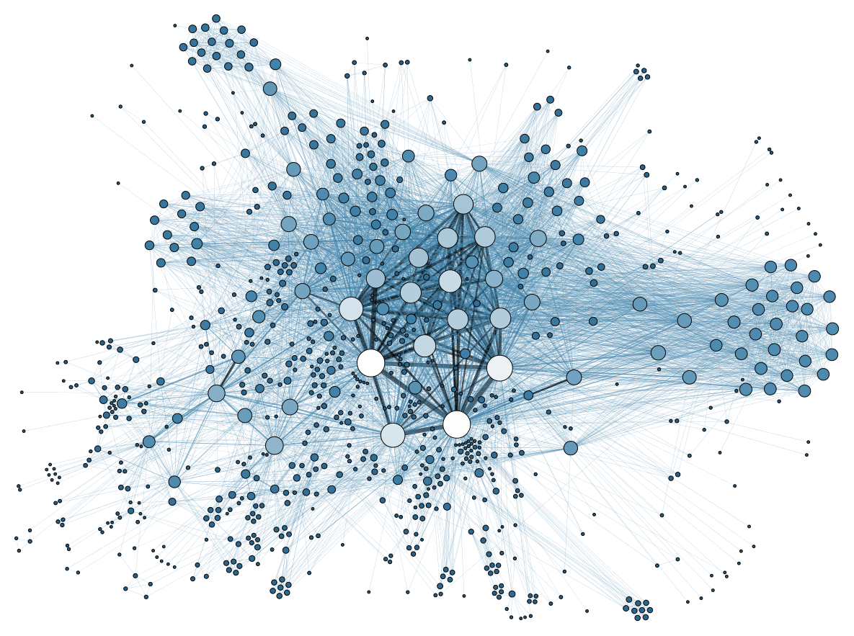

What is metadata analysis?
Download
Analyse
Cloud. Accessed 8/7/19. Public Domain. https://pixabay.com/illustrations/cloud-memory-storage-medium-3805852/
Laptop Notebook Computer. Accessed 8/7/19. Public Domain. https://www.needpix.com/photo/89326/laptop-notebook-computer-free-vector-graphics
Social Network Analysis Visualization.png. Accessed 8/7/19. Public Domain. https://commons.wikimedia.org/wiki/File:Social_Network_Analysis_Visualization.png

Slide 4
Getting the metadata.
Identify the databases
A list of databases the UNE holds subscriptions to is available here: http://une.au.libguides.com/az.php?
Extract the metadata
Bulk download
Web scraping

Slide 5
Getting the metadata.
Different types of Databases
Open access - you can freely download and use the metadata.
Proprietary - owned by a company and UNE pays to access the database
May be download limits on metadata
APIs for commercial databases are not openly available
Scraping of commercial databases may not be ethical
May get in trouble for scraping too much

Slide 6
Context to today’s presentation.
We have a large amount of metadata pulled form Crossref (https://www.crossref.org/)
Crossref is Open Access (REST API: https://github.com/CrossRef/rest-api-doc)
Obtained the metadata via bulk download: https://github.com/greenelab/crossref
Used Brian Newbold’s September 2018 release: https://archive.org/download/crossref_doi_dump_201809 crossref-works.2018-09-05.json.xz 33.2GB XZ archive

Slide 7
Method for data extraction
Extracted the xz archive in Linux with the “unxz”
unxz crossref-works.2018-09-05.json.xz
Partitioned the file into chunks with 1 million lines in each chunk to make it more tractable
split -l 1000000 crossref-works.2018-09-05.json.xz split
Read the records from ascii and save them as compressed Rdata
inData <- readLines("splitaa") save(inData,file="splitaa.Rdata")

Slide 8
alphabet <- c("a","b","c","d","e","f", "g","h","i","j","k","l", "m","n","o","p","q","r", "s","t","u","v","w","x", "y","z") length(alphabet) # 26 inFiles <- c() for (i in 1:26) { for (j in 1:26) { inFiles <- c(inFiles,paste0("split",alphabet[i],alphabet[j])) } }
for (i in 1:length(inFiles)) { # i <- 2 cat(i," ") inFile <- inFiles[i] cat(inFile," ") if (file.exists(inFile)) { inData <- readLines(inFile) cat("read ") save(inData,file=paste0(inFiles[i],".Rdata")) cat("saved ") } cat("\n") }

Slide 9
Sample Rdata File: http://marxan.io/downloads/crossref_workshop/splitaa.Rdata
(220 megabytes)
Sample Source Code: http://marxan.io/downloads/crossref_workshop/crossref_workshop_11Jul2019.R
In the sample code:
change read and write directory, and
install the packages “rjson”, “sqldf”, and “data.table”.

Slide 10
Extract affiliation name from JSON data
Which publication are affiliated with UNE?
Extract affiliation name using splitaa.Rdata (see Sample Source Code file)

Slide 11
Query affiliation name and extract UNE affiliated JSON records
Which authors are affiliated with UNE?
Use “grep” function to search for keywords associated with UNE. For example:
university of new england une 2351
Armidale Australia nsw

Slide 12
Extract “title” for UNE affiliated JSON records
Extract common metadata elements for UNE affiliated records and put them in a table.
Example of some metadata elements extracted:
Publisher issue DOI source
ISSN subject author URL

Slide 13
Activities
Activity 1
Extract metadata for this DOI: 10.1177/0040517514545256
Activity 2
Extract metadata for this subject: Ecology

Slide 14

Licensing: Attribution-NonCommercial-NoDerivatives 4.0 International (https://creativecommons.org/licenses/by-nc-nd/4.0/)
Matt Watts, Kristal Spreadborough, R Support Group presentation, 12 July 2019, The University of New England

